Slide 1

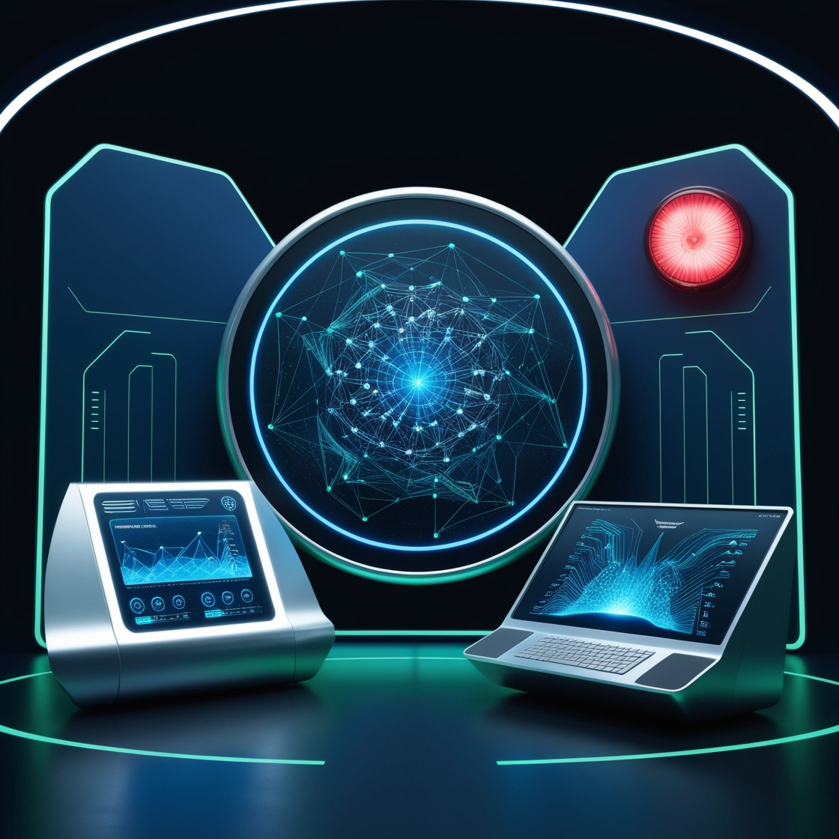


ENTERPRISE SYSTEM MANAGEMENT
Presented By :-
Mayank Kumar
Pulkit Agarwal
Ashwin Dhumal
Pratiksha Gandhi
Vidhi Sharma
Aditi Singh

Slide 2
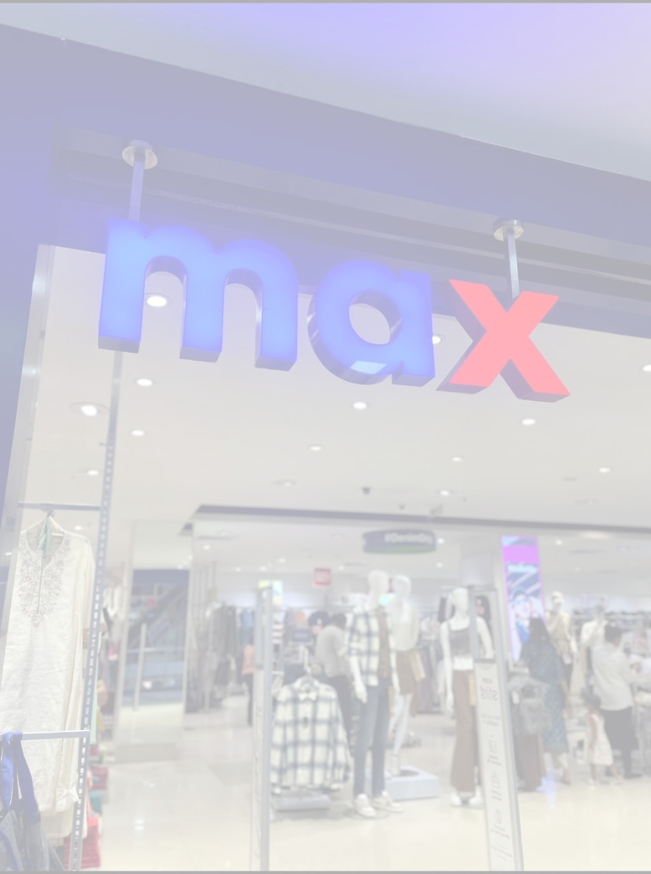

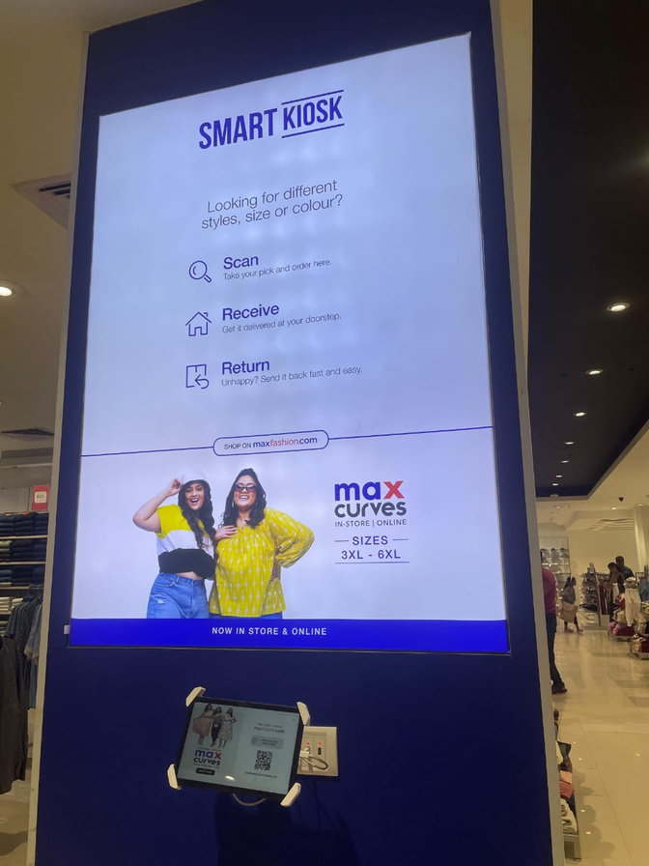

MAX
We believe, fashion is for everyone. From the Gen Z shopper looking for cutting-edge global fashion, to each and everyone in the family seeking quality essentials, Max Fashion has it all.
Information System used - Endless L
It comes under Lifestyle International Pvt. Ltd.
Technology - Barcode scanner for pricing and employee identification.
Price - 25000 to 30000

Slide 3

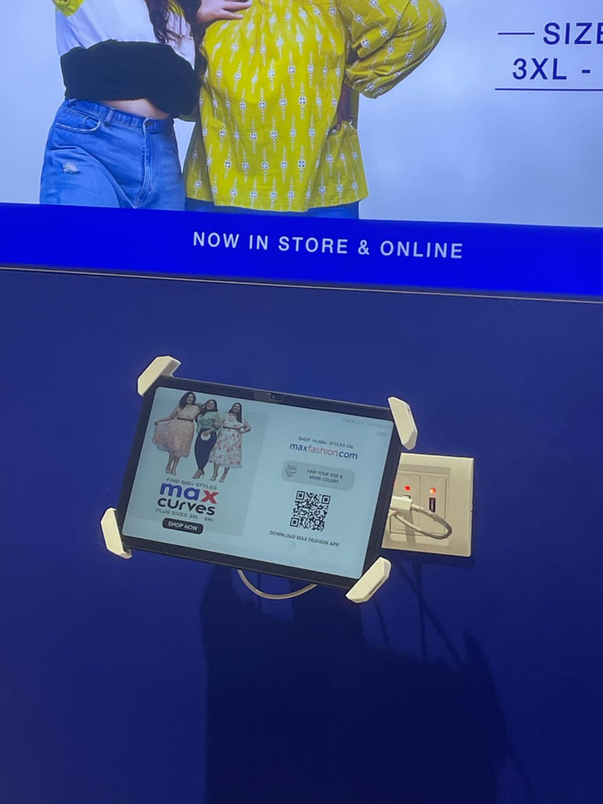
CHALLENGES FACED BY EMPLOYEES
Employee Retention
Retaining customer
Order Issues : Resolved through remote assistance (AnyDesk).
Payment Issues : Online payment and order tracking problems handled in favor of cash on delivery (COD).
Customer Service : Addressing billing counter problems.

Slide 4
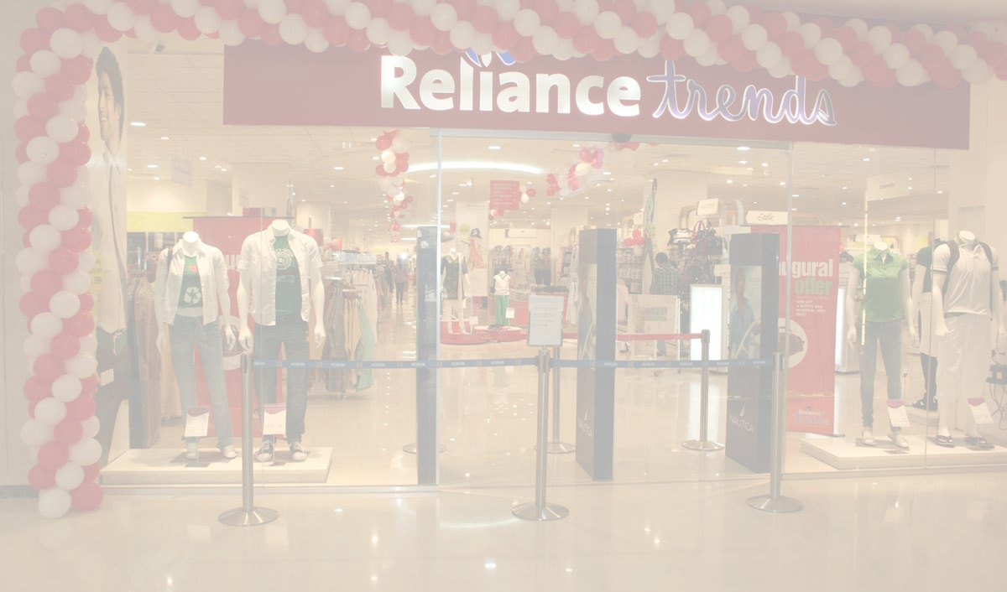
RELIANCE TRENDZ
Reliance Trendz is a fashion retail brand under Reliance Retail, which is a subsidiary of Reliance Industries Limited, one of the largest conglomerates in India.
Scalability: SAP ERP can grow with large businesses, handling complex operations and a lot of transactions.
Customization: SAP ERP can be customized to fit the specific needs of a business like Reliance Trends.
Integration: It connects different parts of the business—like finance, inventory, and sales—into one system.
Real-time Data: SAP ERP provides up-to-date information, helping businesses make quick and informed decisions.

Slide 5

SAP :-
We use SAP for stock details .
In that all stock details are found .
From product EAN number .
All products have an article number which only sells in that store only.
Sap is use for all purpose only for stock in retail sector .
Sap is using by all companies by different different format . Hence it has use for multiple work .
The price of SAP software typically ranges from Rs 83000 to Rs 530438 per user, with additional costs for implementation and maintenance.
SAP having t- code
Z store
Ztorehht
Me2n
Me29n

Slide 6
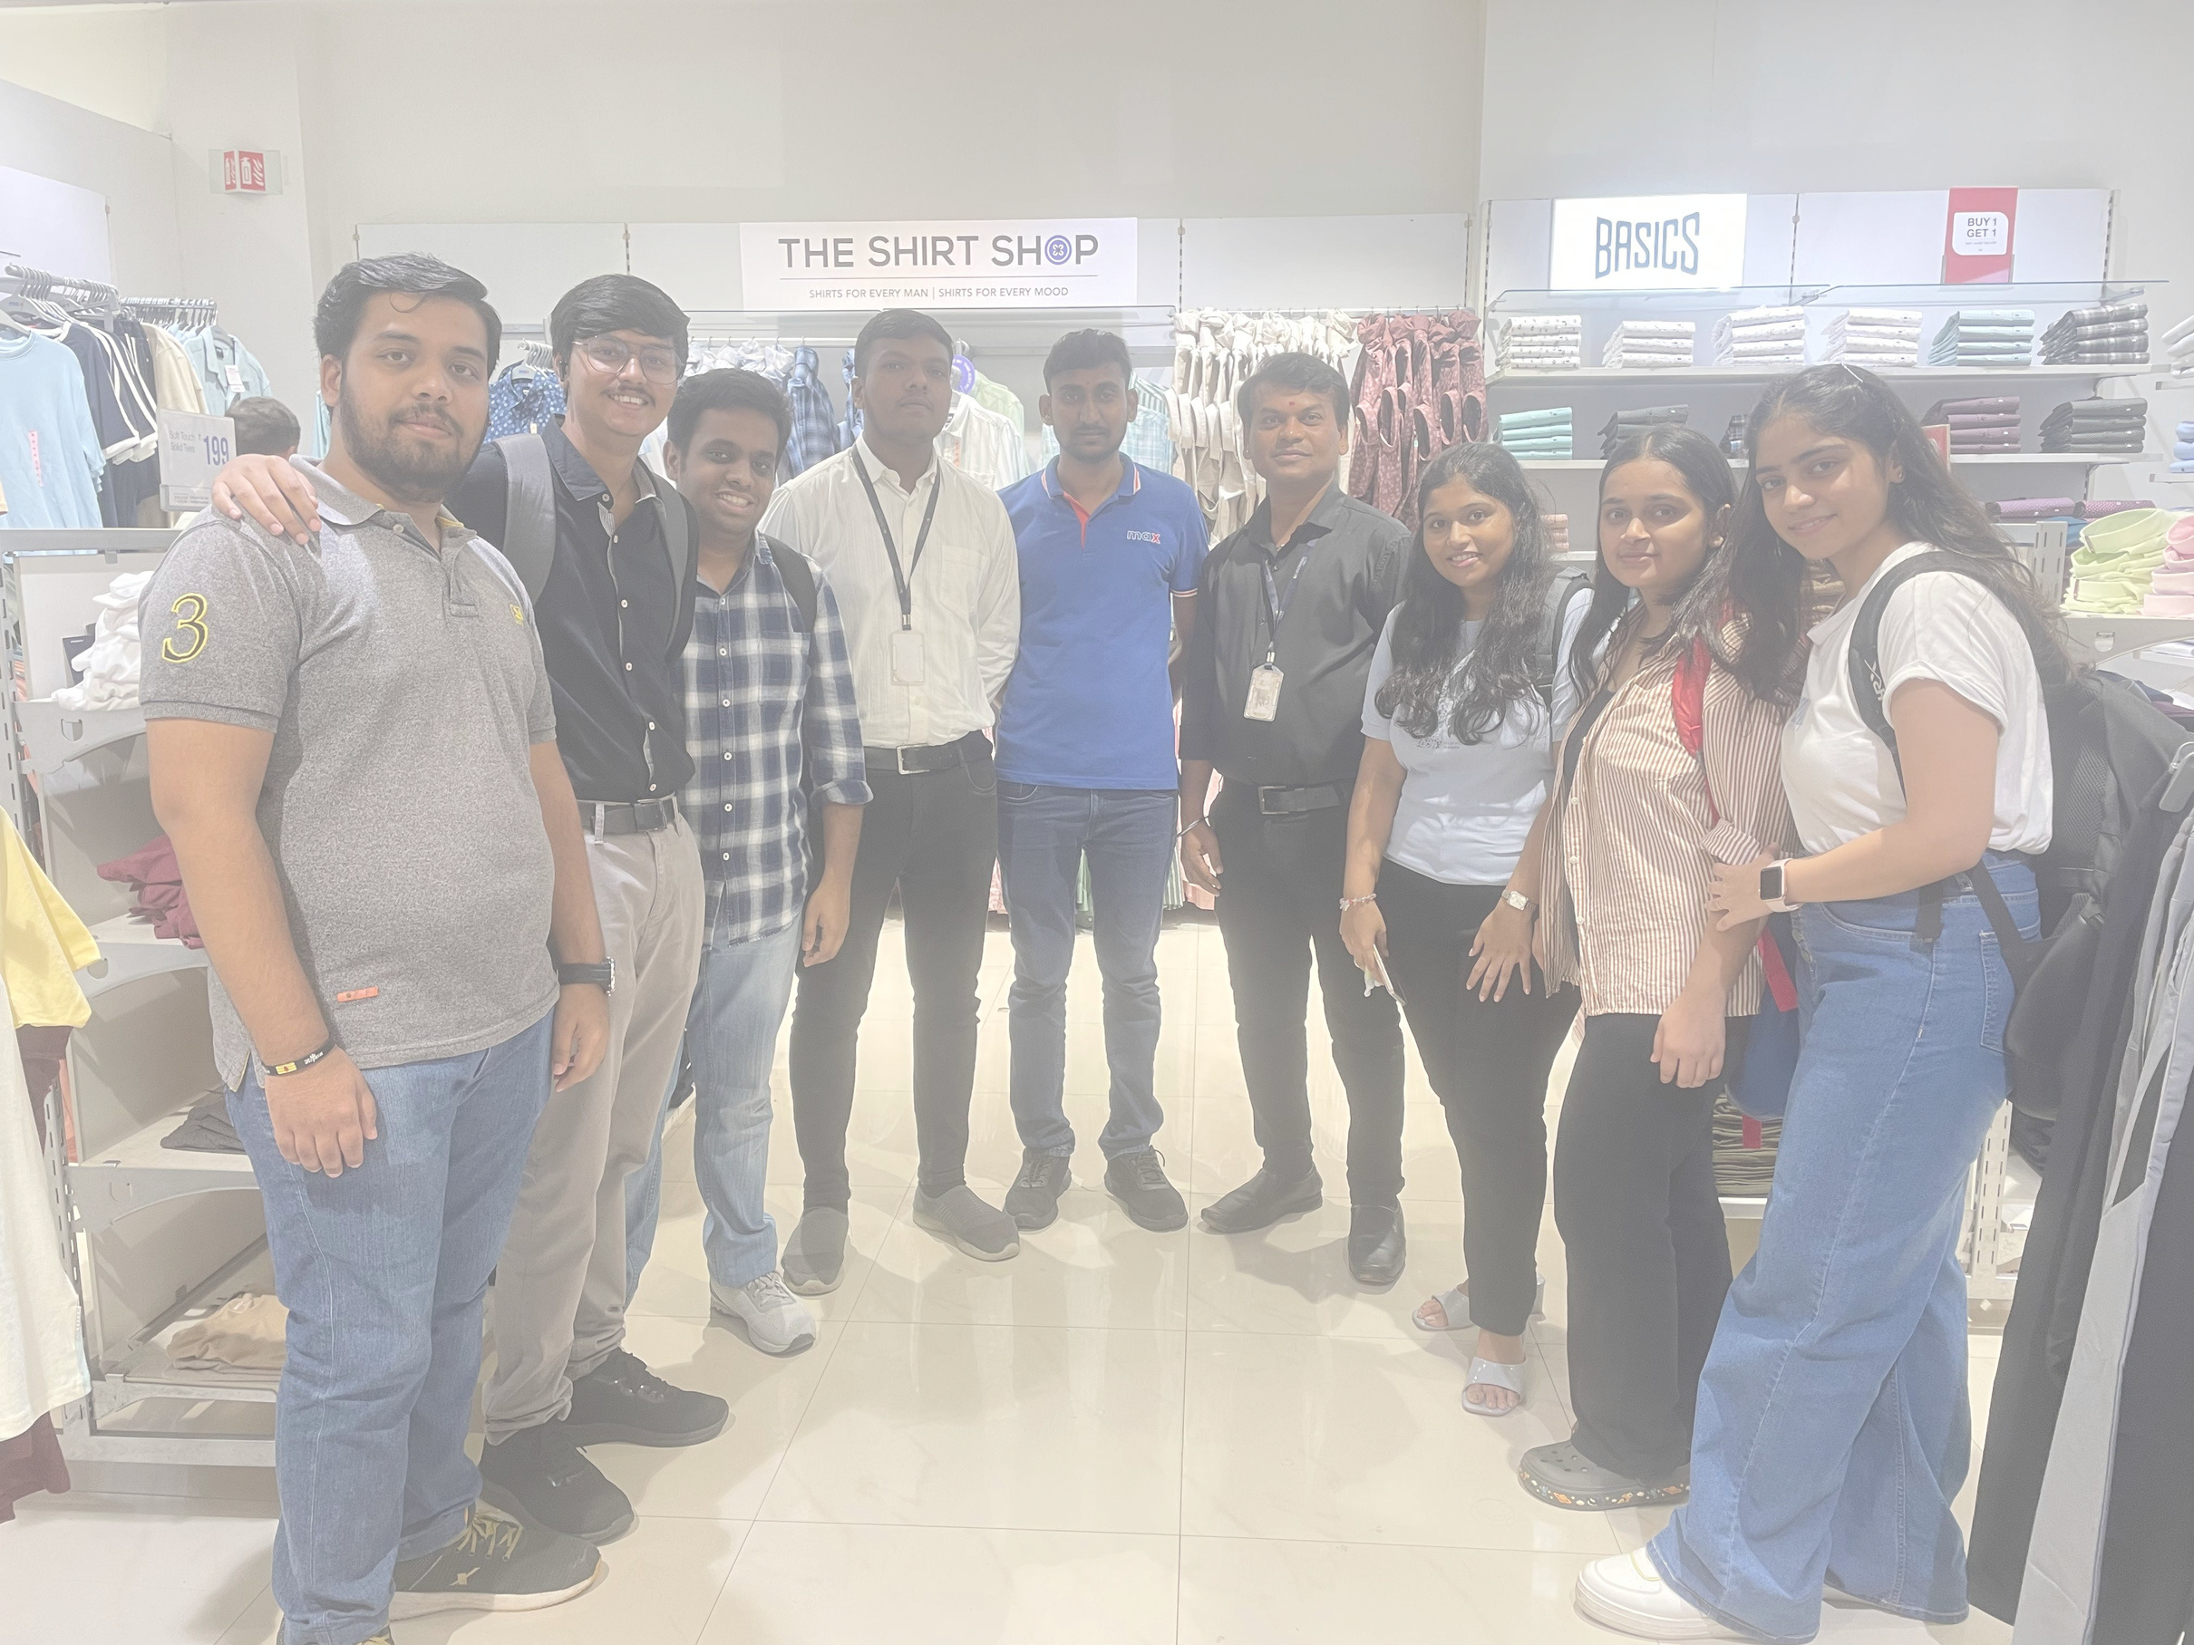

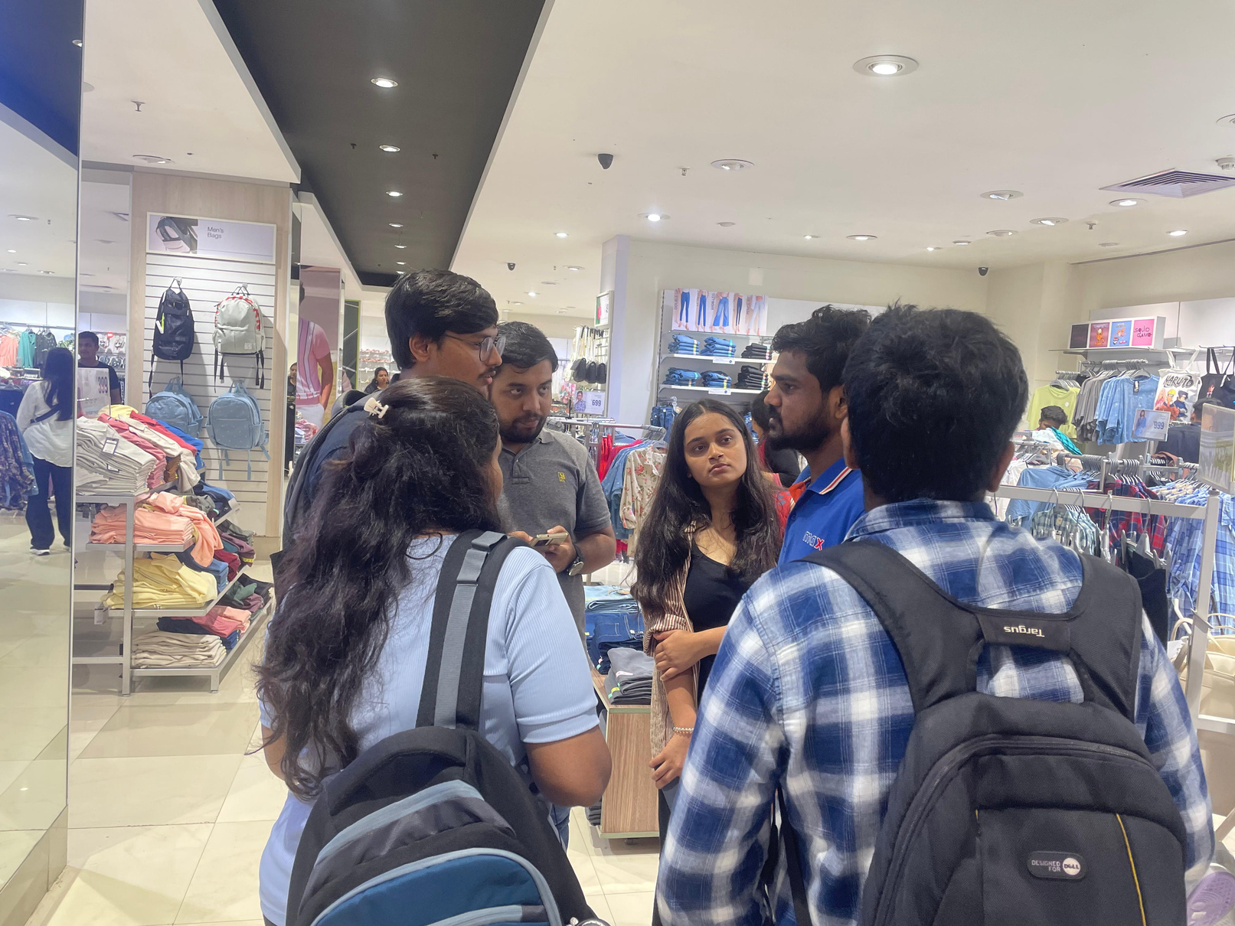
TESTIMONIALS

Slide 7
THANK YOU :-

